Slide 1




HOPE TO SKILL
Lecture 40
Retrievals
& LLMs
Artificial Intelligence Advance Course

Slide 2





AI INSTRUCTORS
Dr.Irfan Malik
Dr.Sheraz Naseer
Hassan Mahmood
Ramsha Imran
M.Haris Tariq

Slide 3


Previous Lecture Topics
01
Vector Stores
02
Local Vs Cloud Storage
03
Practically Implementation

Slide 4
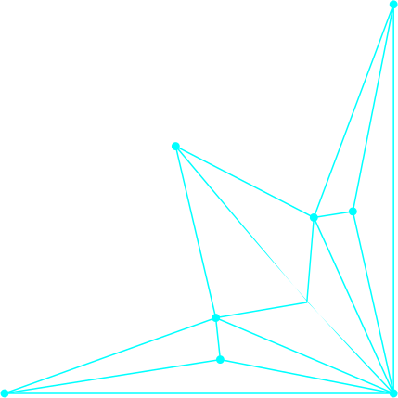


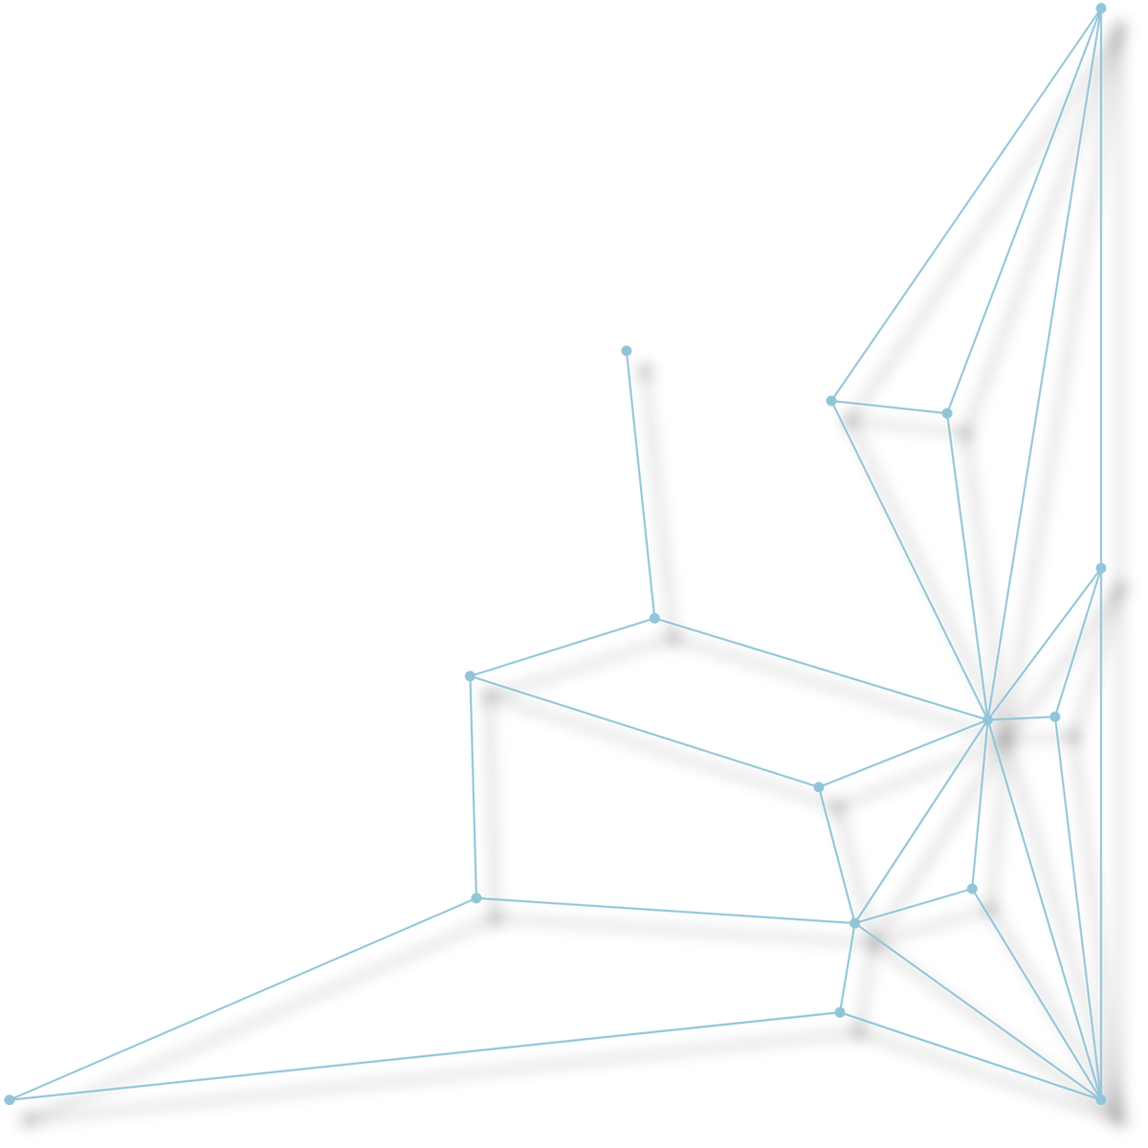
Outline
Retrievals
Introduction to LLMs

Slide 5

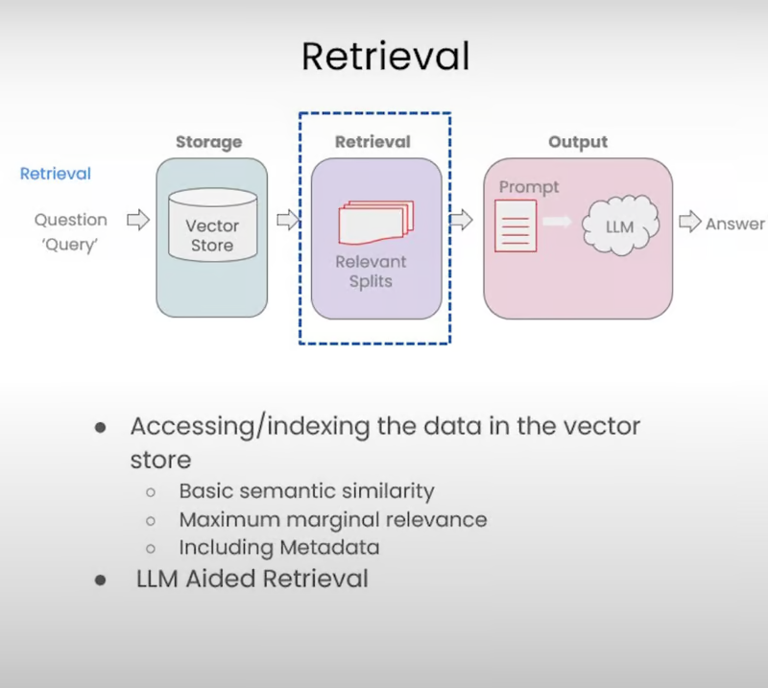
Vector Store as a Retriever
A vector store retriever uses a vector store to retrieve documents. It is a lightweight wrapper around the vector store class to make it conform to the retriever interface.

Slide 6

Vector
Store as a
Retriever
Semantic
search
MMR

Slide 7
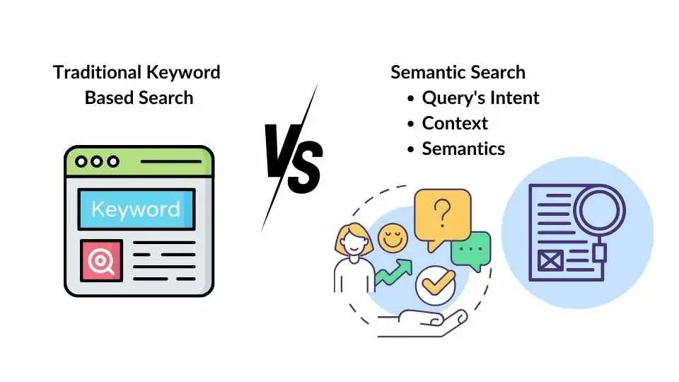
Semantic Search
Semantic search goes beyond keyword search (which relies on the occurrence of specific index words in the search input) to find contextually relevant data based on the conceptual similarity of the input string.
By default, the vector store retriever
uses similarity search.

Slide 8

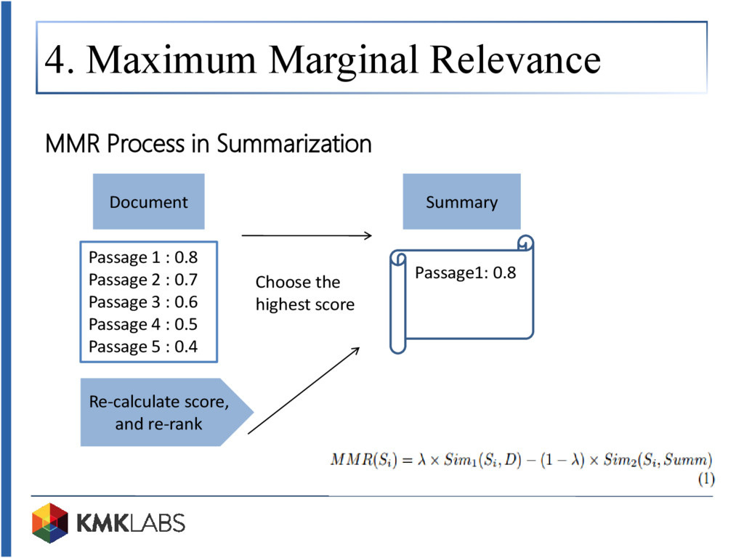
Maximal Marginal Relevance (MMR)
Maximal Marginal Relevance MMR is a method used to avoid redundancy while retrieving relevant items to a query.

Slide 9

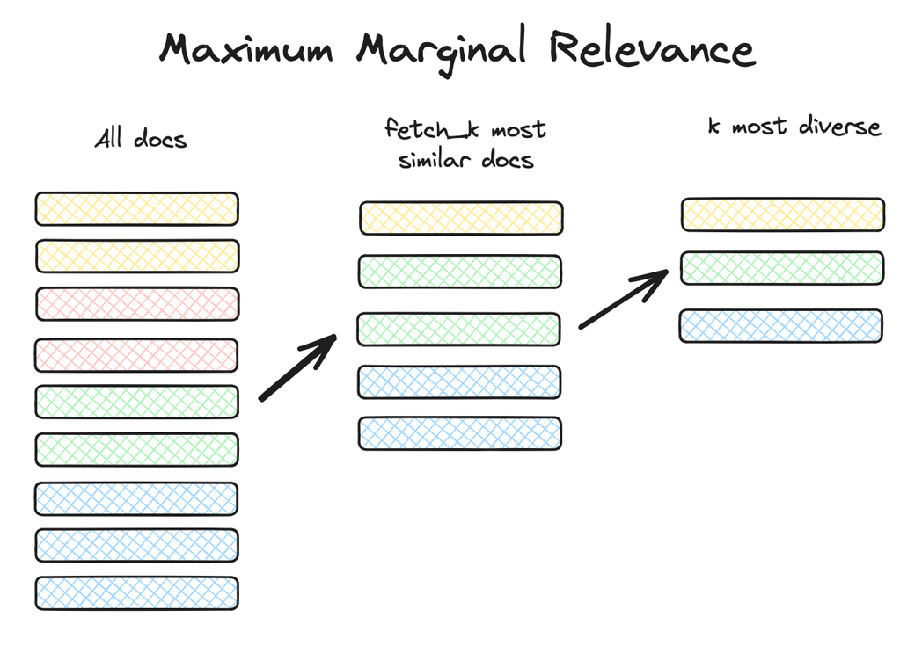
Maximal Marginal Relevance (MMR)
Instead of merely retrieving the most relevant items
(which can often be very similar to each other), MMR
ensures a balance between relevancy and diversity
in the items retrieved.

Slide 10


Other Retrievals
SVM
TF/IDF

